Slide 1


Data Science Academy:
Newton Data Analytics
February 8, 2020

Slide 2
Introduction

Slide 3
Google Classroom
We’ll be using Google Classroom for our learning platform. All materials, assignments, additional materials, and announcement will all be posted through class. Join the Classroom by entering your class code: mizicyp
Download material
Pay attention to assignment deadline
Don’t miss additional material posted on Stream
PS: Google Classroom mobile application is available on Android and iOS

Slide 4
Grading Elements
By the end of each course, students will be assigned on a graded quiz assignment which needed to be completed in class during given time.
Teaching team will share detailed instructions on the quiz day (scoring & maximum attempt).
Students who don’t pass or encounter any issues on quiz day may request a makeup quiz in the final week of specialization.
Any quiz that done out of quiz hours will be considered invalid.
By the end of this specialization, students will be assigned on a graded project assignment which needed to be completed during given time.
Students required to pass the given rubrics of each capstone project

Slide 5
Where to get help?
Every question can be asked through mentor@algorit.ma. Practice a know-how to ask a question on online forums. Every forums has a general rules in asking good questions, for example: Quora, StackOverflow, GitHub etc.
All email received in mentor@algorit.ma will be answered by our team and are tracked using ticketing system that should be addressed within 9 business hours.
Teaching assistant and lead instructor email will also be cc’ed on course email reminder.

Slide 6
What you will learn?

Slide 7
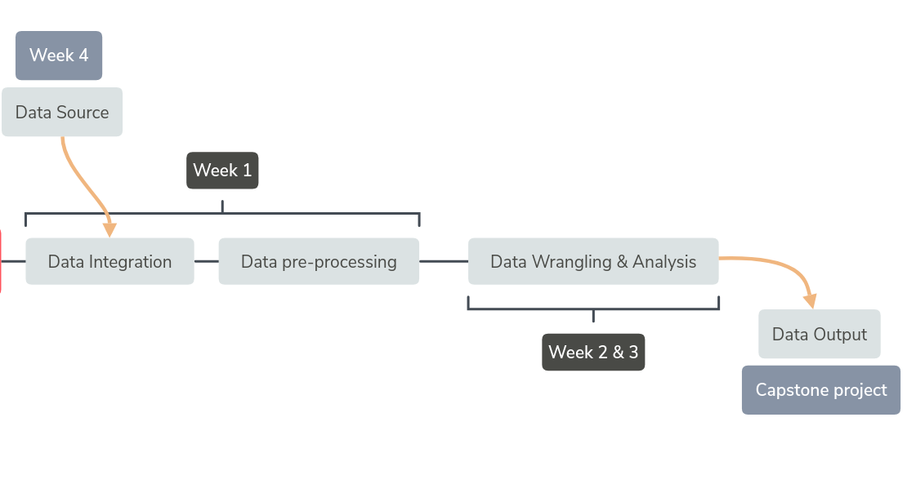
Data Analytics Specialization
Week 1: Python for Data Analysts (P4DA)
Week 2: Exploratory Data Analysis (EDA)
Week 3: Data Wrangling and Visualization (DWV)
Week 4: SQL and Capstone Project

Slide 8
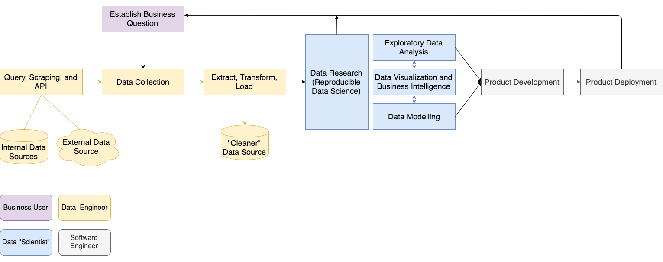
Data Project Lifecycle

Slide 9
Why python?

Slide 10
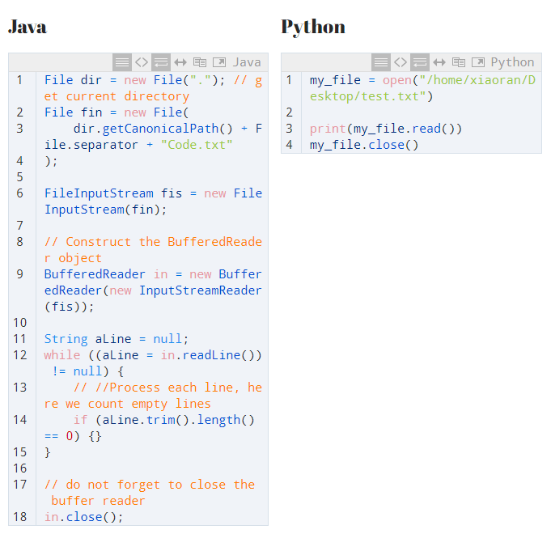
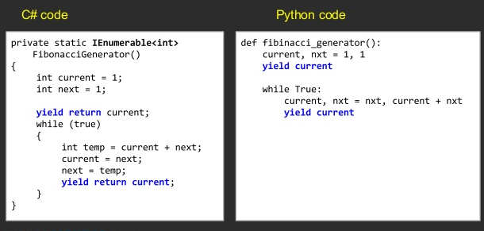
Code Simplicity and Readability

Slide 11
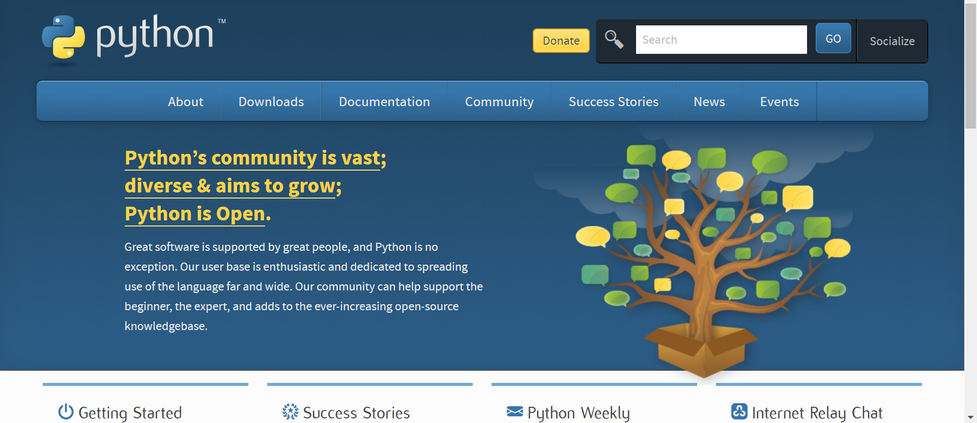
Open Source and Vibrant Community
https://www.python.org/community

Slide 12
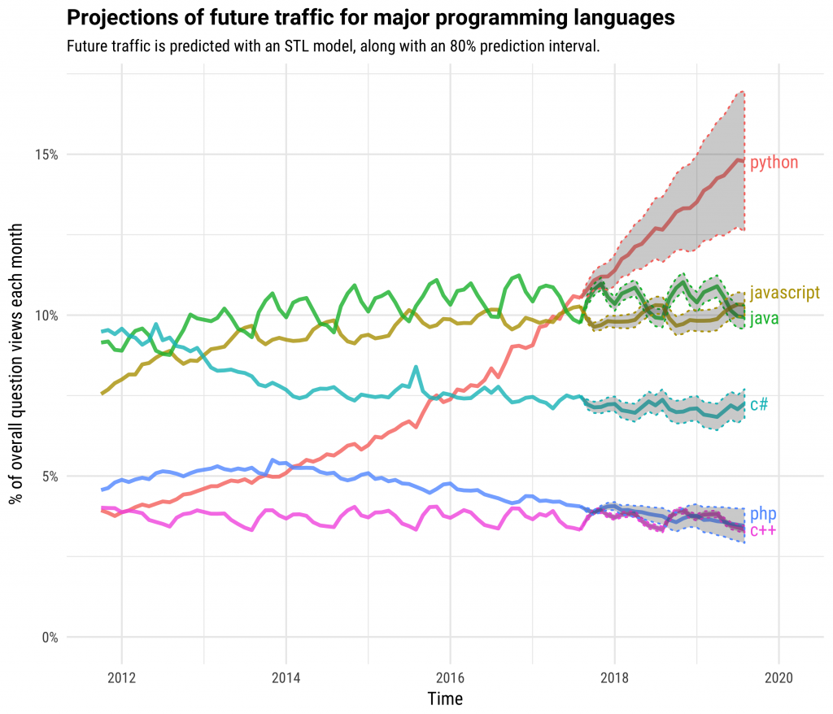
In Demand
The latest report from Forbes states that Python showed a 456-percent growth in last year.
Source: Indeed

Slide 13
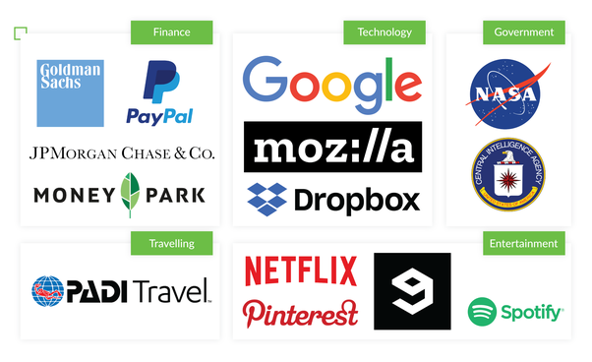
In Demand

Slide 14
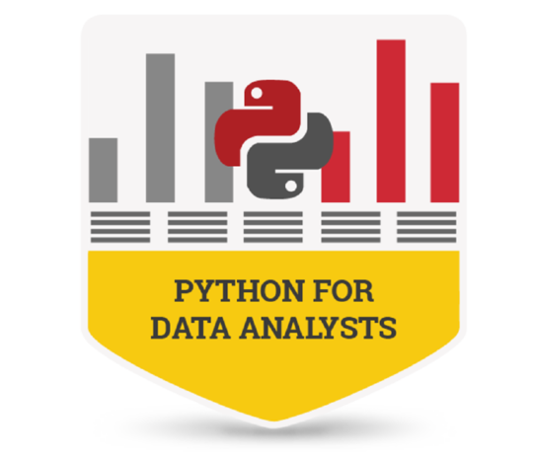
Python for Data Analyst

Slide 15
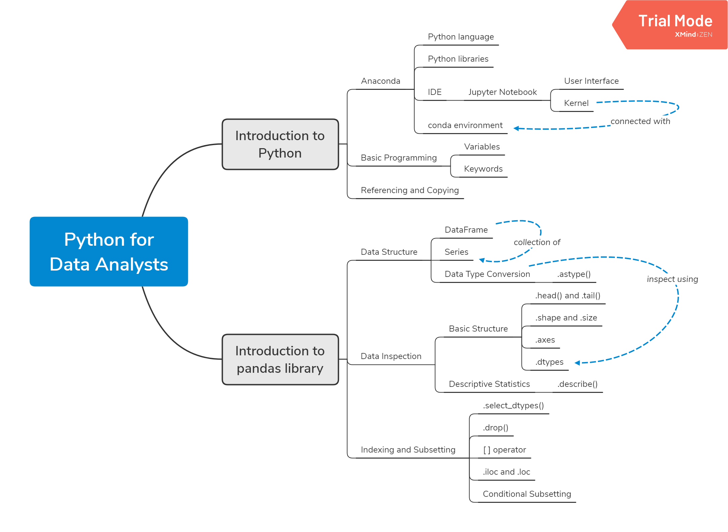
Training
Objectives

Slide 16

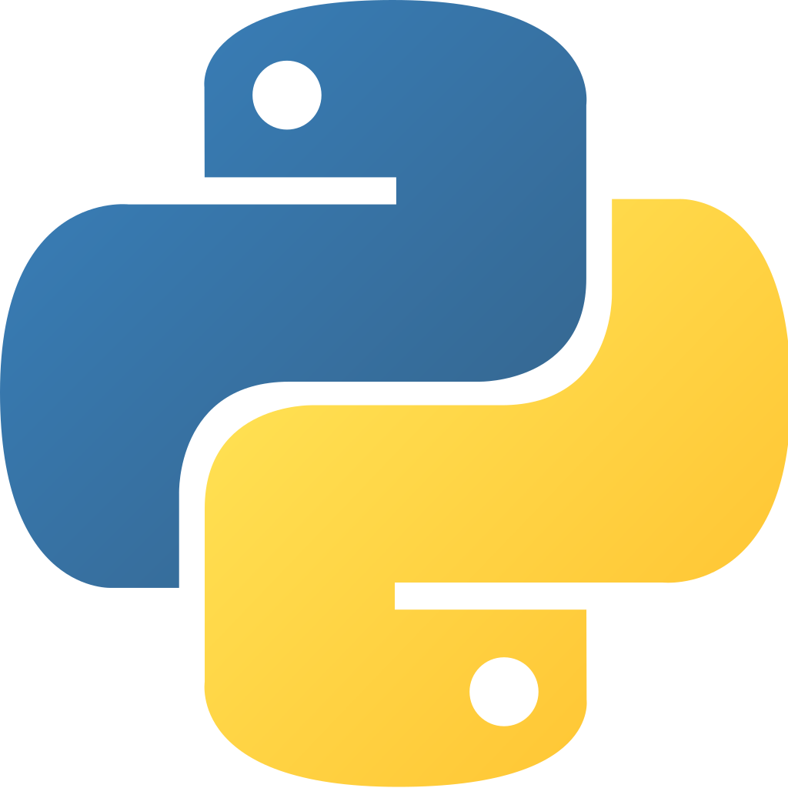

Prerequisite

Slide 17
What is Anaconda/Miniconda?
Anaconda is a python distribution. It aims to provide everything you need (Python-wise) for data science.
It includes:
The core Python language
100+ Python "packages" (libraries)
Spyder and Jupyter (IDE/editor - like PyCharm)
conda, Anaconda's own package and environment

Slide 18
Anaconda as environment manager
conda env list
An environment consists of a certain Python version and some packages.
Consequently, if you want to develop or use applications with different Python or package version requirements, you need to set up different environments.

Slide 19
Why do we need Python environments?
So why exactly do you need Python environments? You might ask: shouldn’t I just install the latest Python version?
You have an application (developed by yourself or by someone else) that once worked beautifully. But now you’ve tried to run it, and it is not working. Perhaps one of the packages is no longer compatible with the other parts of your program (due to the so-called breaking changes).
You are collaborating with someone else, and you want to make sure that your application is working on your team member’s computer, and vice versa, so you can also set up an environment for your co-worker’s application(s).
You are delivering an application to your client, and again, you want to make sure that it is working smoothly on your client’s computer.

Slide 20
What is Jupyter Notebook?
Jupyter Notebook provides an easy-to-use, interactive data science environment that doesn't only work as an IDE, but also as a presentation tool (as it can be exported to other document formats, such as .HTML, .PDF, etc).

Slide 21
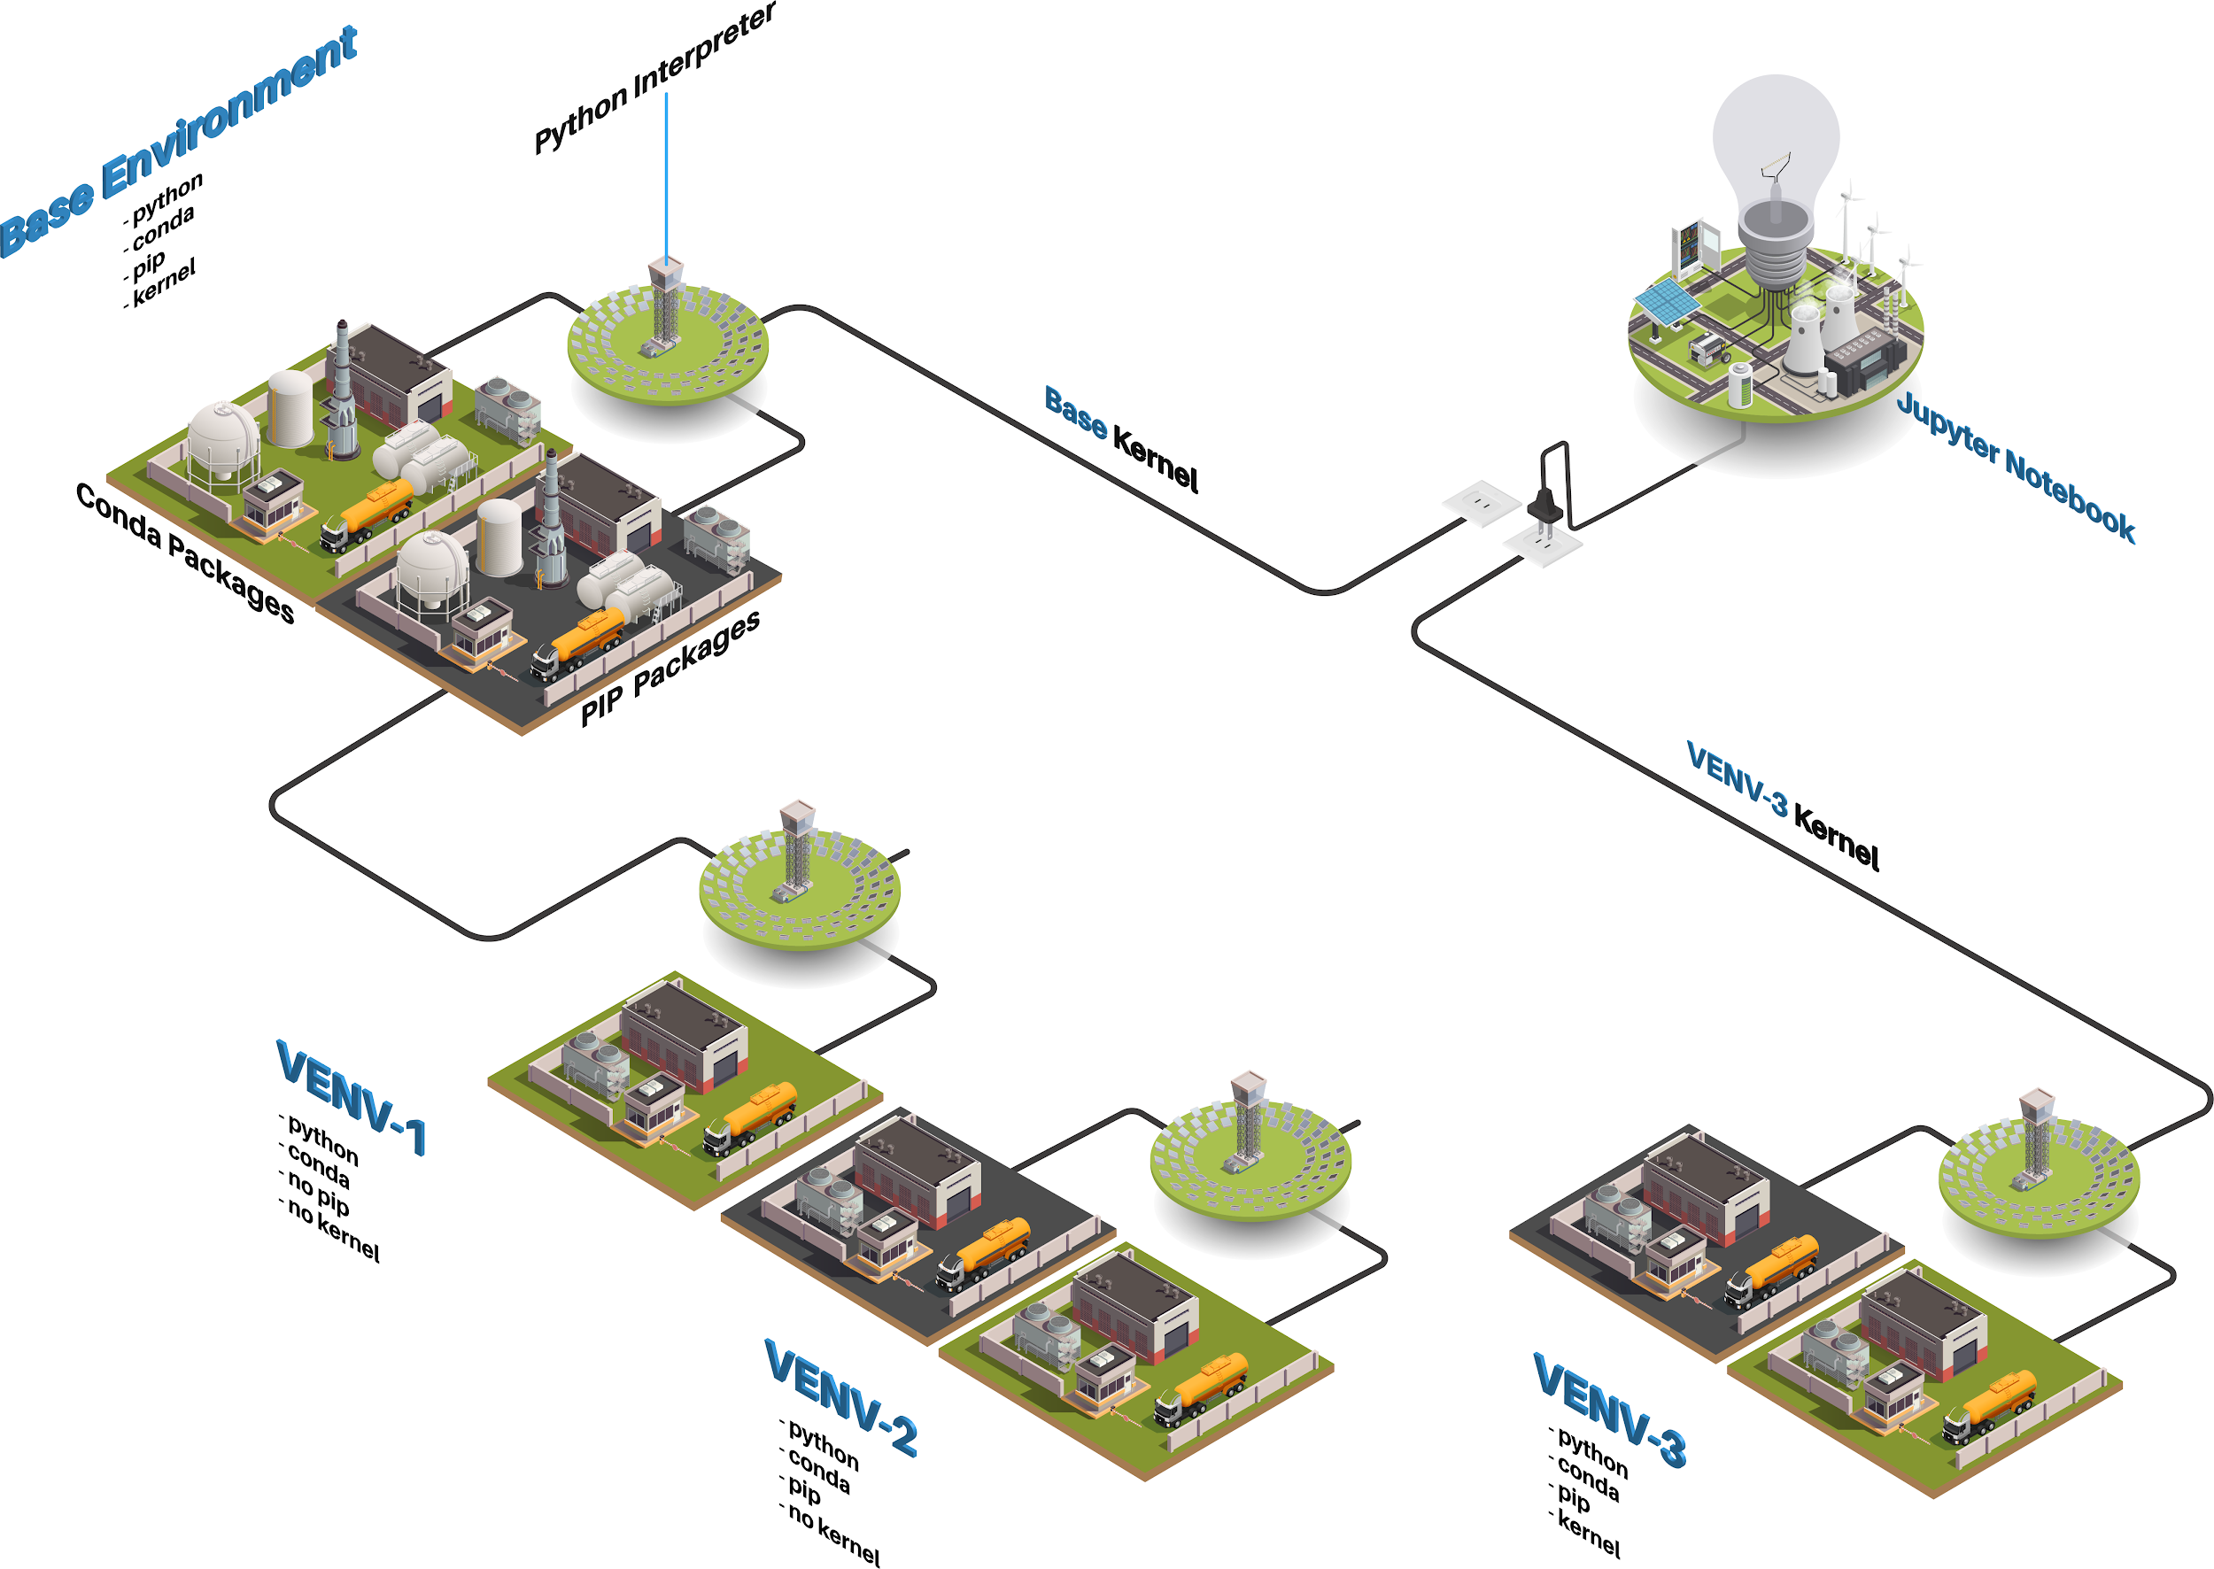

Slide 22
Thank You

